Slide 1
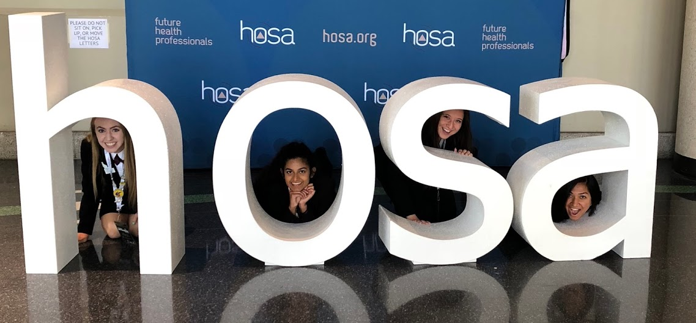
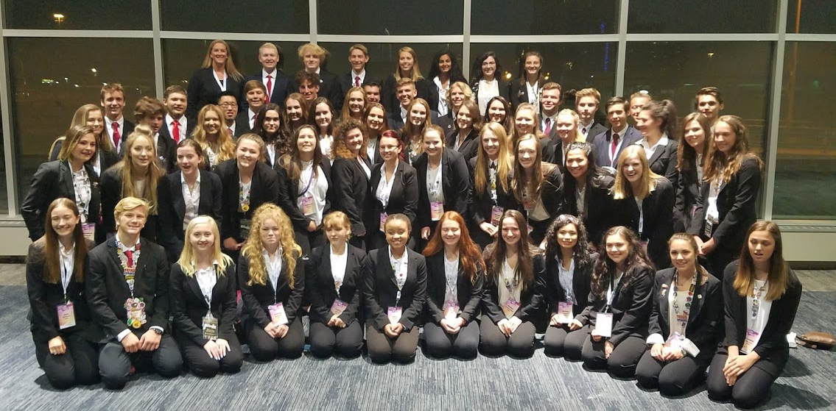
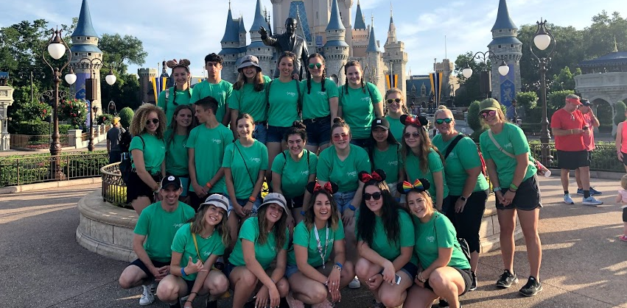
MMACHS
HOSA

Slide 2
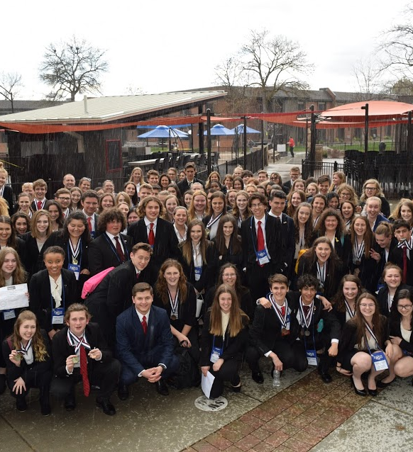
What is HOSA?
Student leadership organization that helps students explore different aspects of careers in the health-care industry.
51 different competitive events along with 6 recognition events
  Examples today:
  CPR / First Aid
  CERT
  Biomedical Debate
  HOSA Bowl
  Public Service Announcement
  Community Awareness

Slide 3
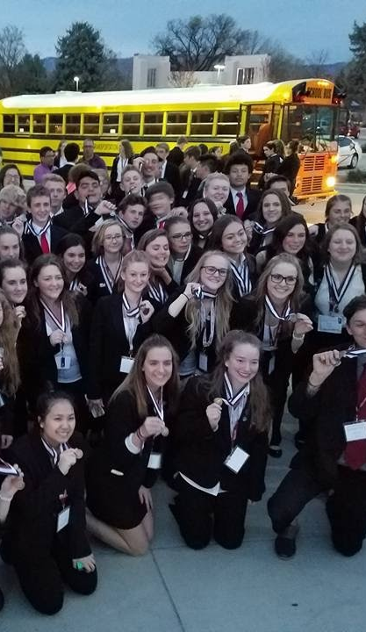
MMACHS HOSA
Advisors:
  Mr. Gaudet – gaudet.blake@westada.org
  Ms. Kerns – staub.carolyn@westada.org
  Mrs. Cindy Ascuena – ascuena.cindy@westada.org
Largest HOSA Chapter in Idaho
Typically around 70% of school participates
Between 100-130 students attend State each year
Between 50-60 students attend Internationals each year

Slide 4
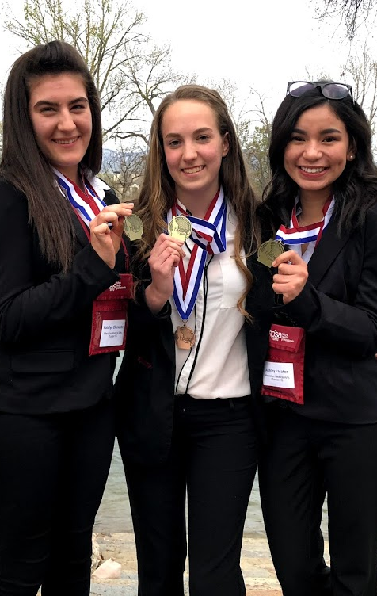
HOSA Pro Dress
Female Attire
Navy Blue or Black Blazer
Navy Blue or Black Slacks
or Business Skirt
White Blouse
Navy Blue or Black Shoes
Male Attire
Navy Blue or Black Blazer
Navy Blue or Black Slacks
White Button Up Shirt
Red Tie
Navy Blue or Black Shoes

Slide 5
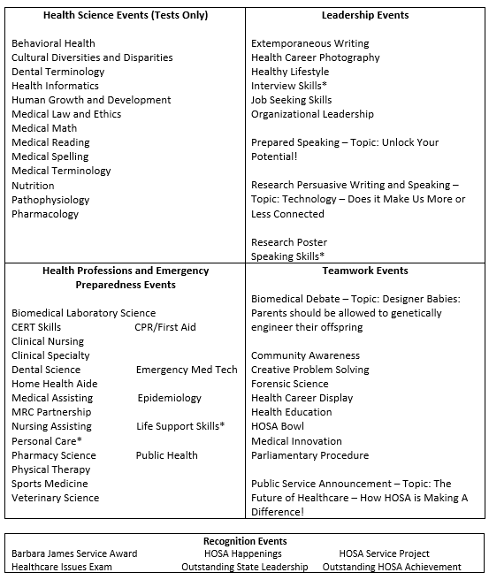
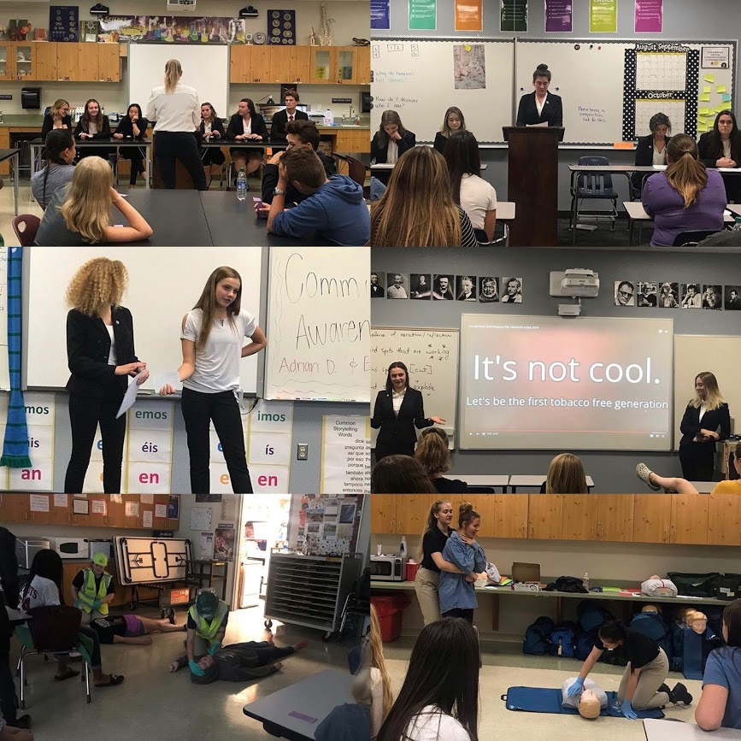
Event Selections

Slide 6
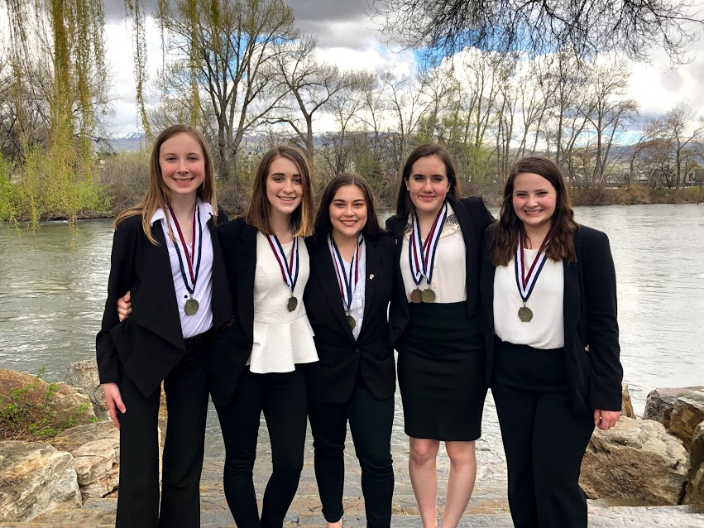
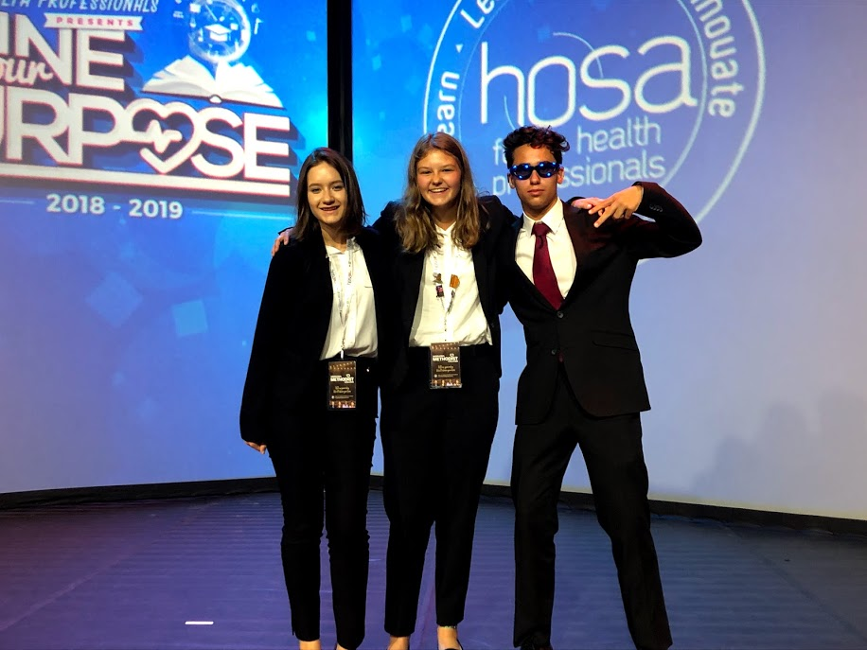
Dates for 2022-23
Regional Competition
Late January – Timberline High school
Chance to practice event, see what where your strengths/weaknesses are
Idaho State Leadership Conference
March 8th – 10th
$100 (unless you sell 15 bags of potatoes)
Idaho State University – Pocatello, ID
International Leadership Conference
June 20th – 25th – Dallas, TX
Costs range from $850 - $1200 depending on flights, etc. Tons of fundraising opportunities through booster program.

Slide 7
How do I know what is expected of my student?
Read over their guidelines!
Link: http://www.hosa.org/guidelines
Click on their event to see details of their competition
How can I help my student succeed?
Encourage them to study or practice in small doses spread apart (no cramming!)
Act as a test audience before their competition
Help them find the resources they need to complete (books, portfolios, posters, etc).
BECOME A BOOSTER! (more info on this later)

Slide 8
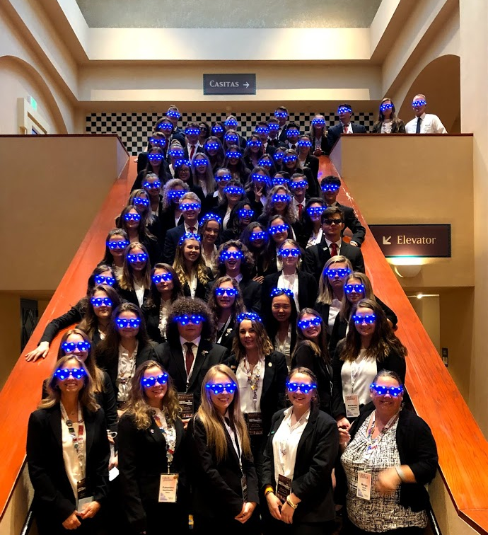
Costs (Typical Year)
Dues - $40
  National Dues, State Dues, T-Shirts
    Only $5 stays with the club for operating expenses
State Competition Attendance - $100
  Covered if you sell 15 bags of potatoes
International Competition – Varies
  Depending on where competition is held, how many students attend, etc.

Slide 9
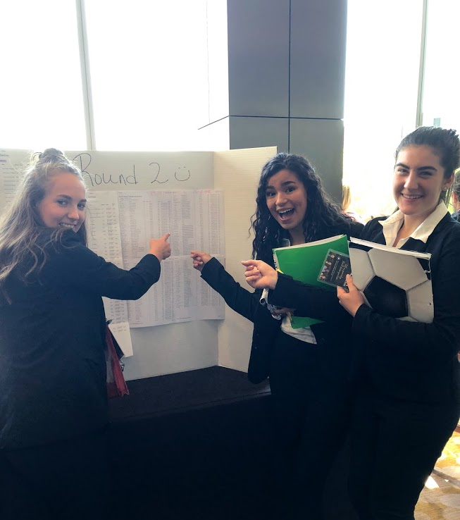
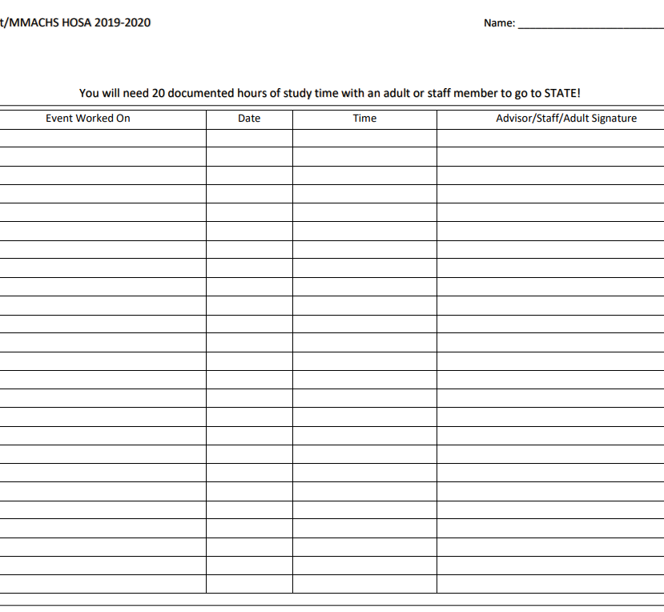

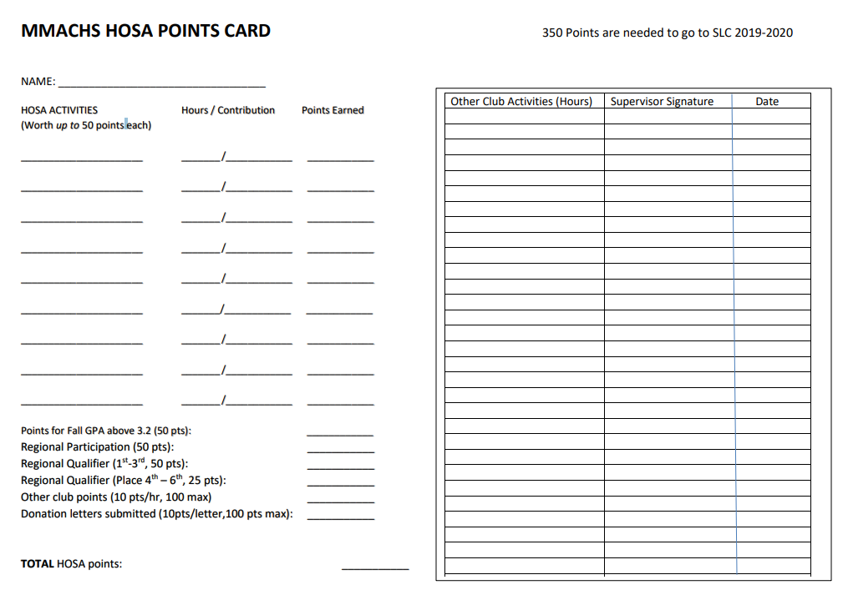
HOSA “Buy In” and Study Hours
Students need to participate in TWO EVENTS and complete 20 Study Hours throughout the year in order to compete at State
Event Examples:
  Volunteering to demonstrate tonight
  Helping out at potato distribution
  Setting up and breaking down our haunted house
  Setting up and breaking down at regionals
  Helping run our Holiday Bazaar.

Slide 10
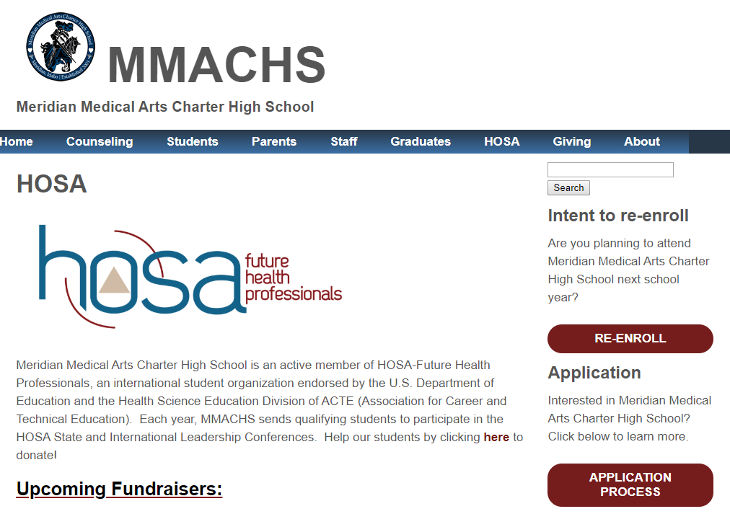
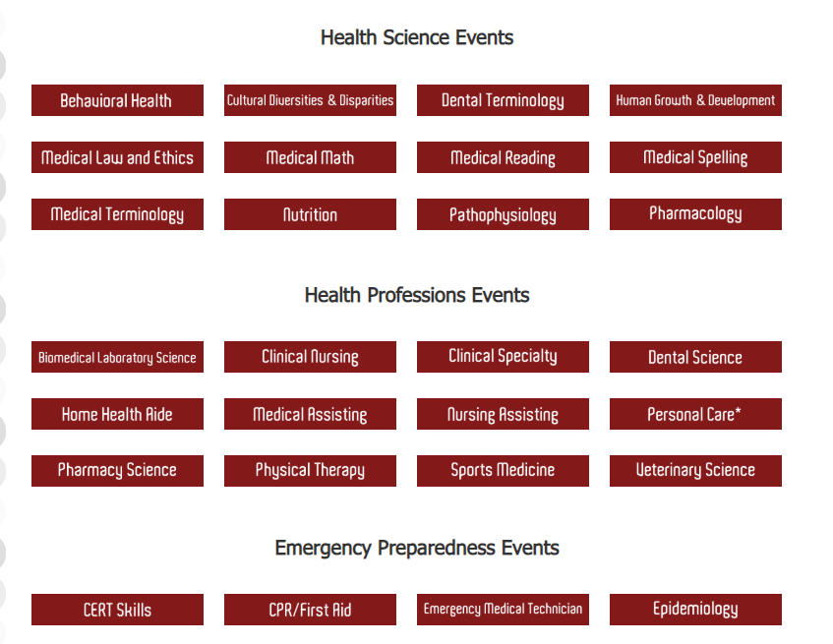
More information…
MMACHS HOSA website - http://www.meridianmedicalartscharter.org/hosa/
HOSA Event Guidelines - http://hosa.org/guidelines

Slide 11
HOSA Boosters

Slide 12

MMACHS HOSA Boosters

Slide 13
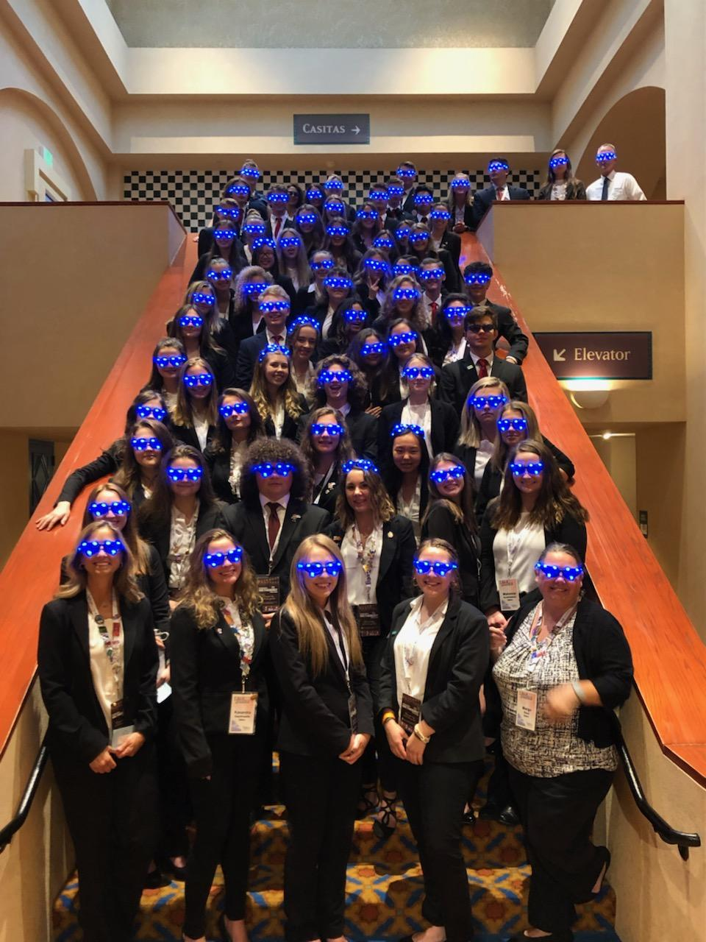
Did you know?
MMACHS has the largest HOSA club in the state?
Our Freshman population competes (and Wins) just as much as our seasoned competitors.
“This is our MMACHS Varsity Sport”
“HOSA helps our students build better peer relationships, stronger leadership & performance skills, and exceed beyond their wildest dreams!”

Slide 14
MMACHS HOSA BOOSTERS
We are essentially the
“PTA” of Meridian Medical Arts
MMACHS students work hard and set big goals for themselves. We want to encourage and support them in their journey.

Slide 15
We meet the
2nd Tuesday of each Month
Our Next Meeting is
Next Tuesday September 13, 2022 @ 6:30
MMACHS - Social Center
No commitment – Just come say hi, come to volunteer when needed, or come just to know what is going on.

Slide 16

Who are your board members?
Brook Heath; President Senior Parent
Gary Van Ackern; Vice President Junior Parent
Kelley Curtis; Treasurer Sophomore Parent
Mary Swanke; Secretary Senior Parent
Blake Gaudet; Staff Advisor
Jessica Kerns; Staff Advisor
Garry Heath, Adam Greyson and Malissa McCulloch; Members-At-Large

Slide 17
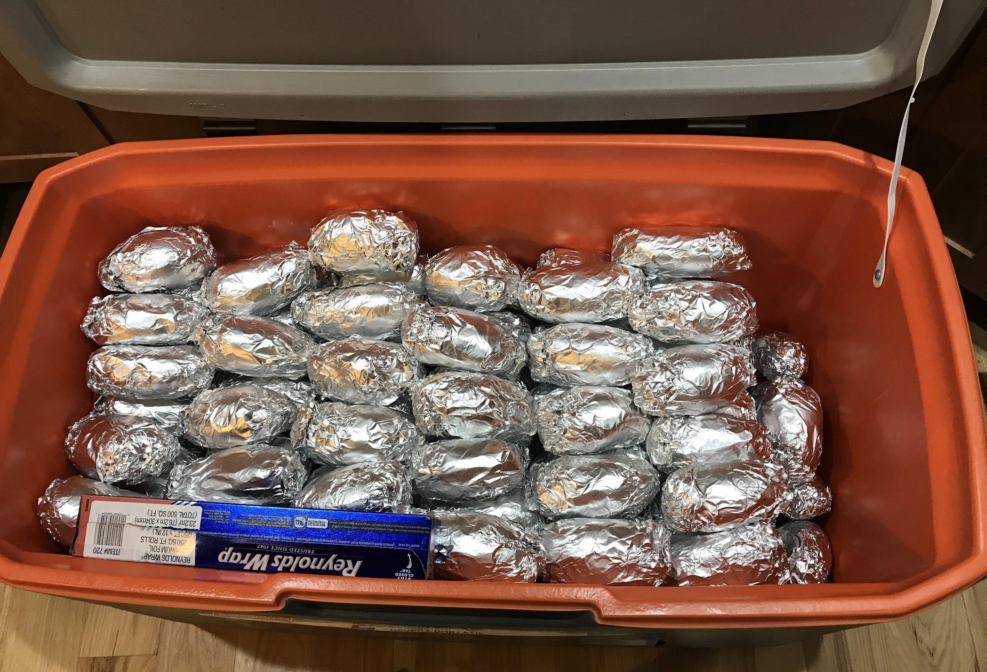
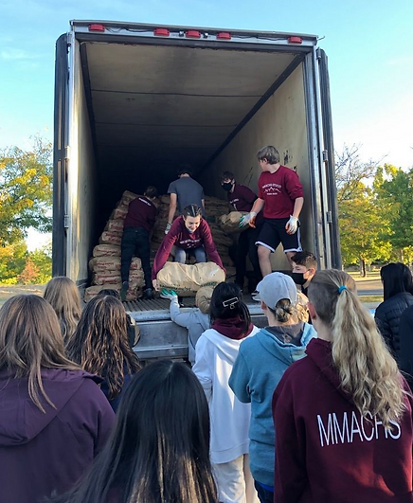
We are additional support for our MMACHS students and families Not everything is HOSA, :)
Student events and Volunteer Fun
  Back to School Night
  Halloween Haunted House
  Holiday Bazaar
  Social Nights/Activities
  Teacher Appreciation
Notes:
Boosters support Back to School Night.
We use it to share who we are as a club
Welcome new families and faces
Increase parent involvement.
kickoff our Spud-Raiser event.
* this year we were cancelled due to
pandemic restraints.

Slide 18
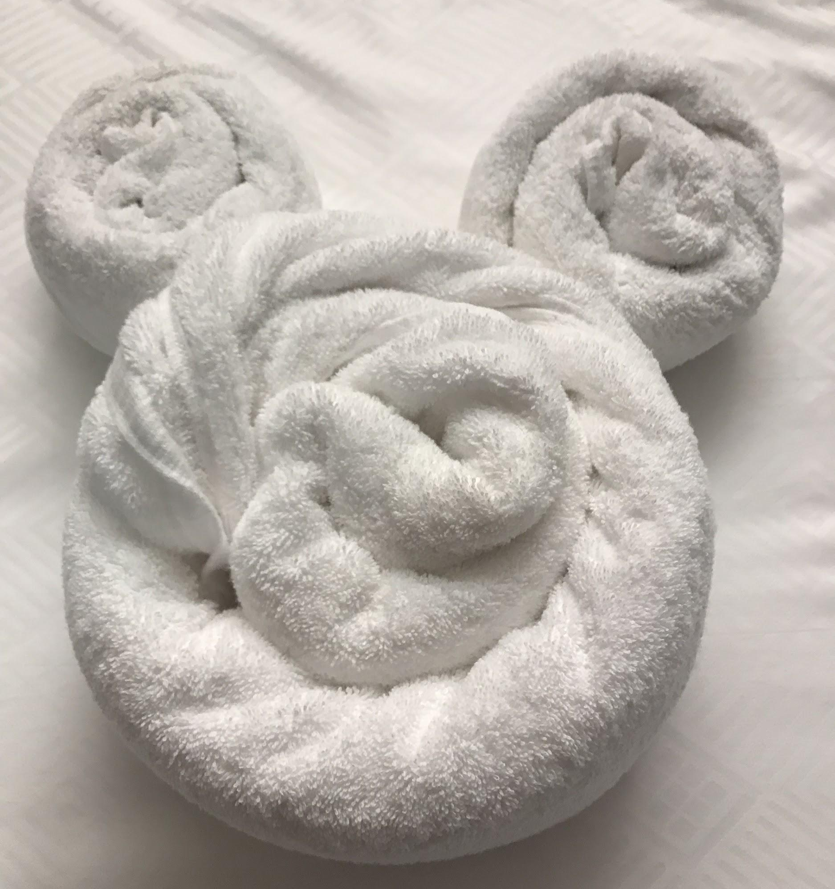
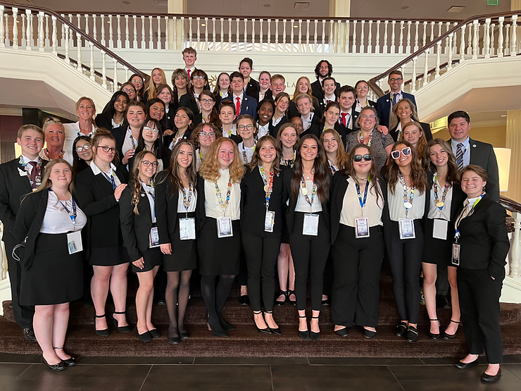
Fundraisers
We generally do two BIG fundraisers a year.
  Fall Fundraiser
    Spud Raiser (largest group fundraiser)
    50lb bags of Idaho potatoes for $25.00 each.
    largest amount raised was $31,000.00 in 2021!
  Spring Fundraisers-
    Gift Card Raffle $25 buy in. So much fun
MMACHS stickers - ongoing with student involvement
Always looking for new fun ideas!

Slide 19
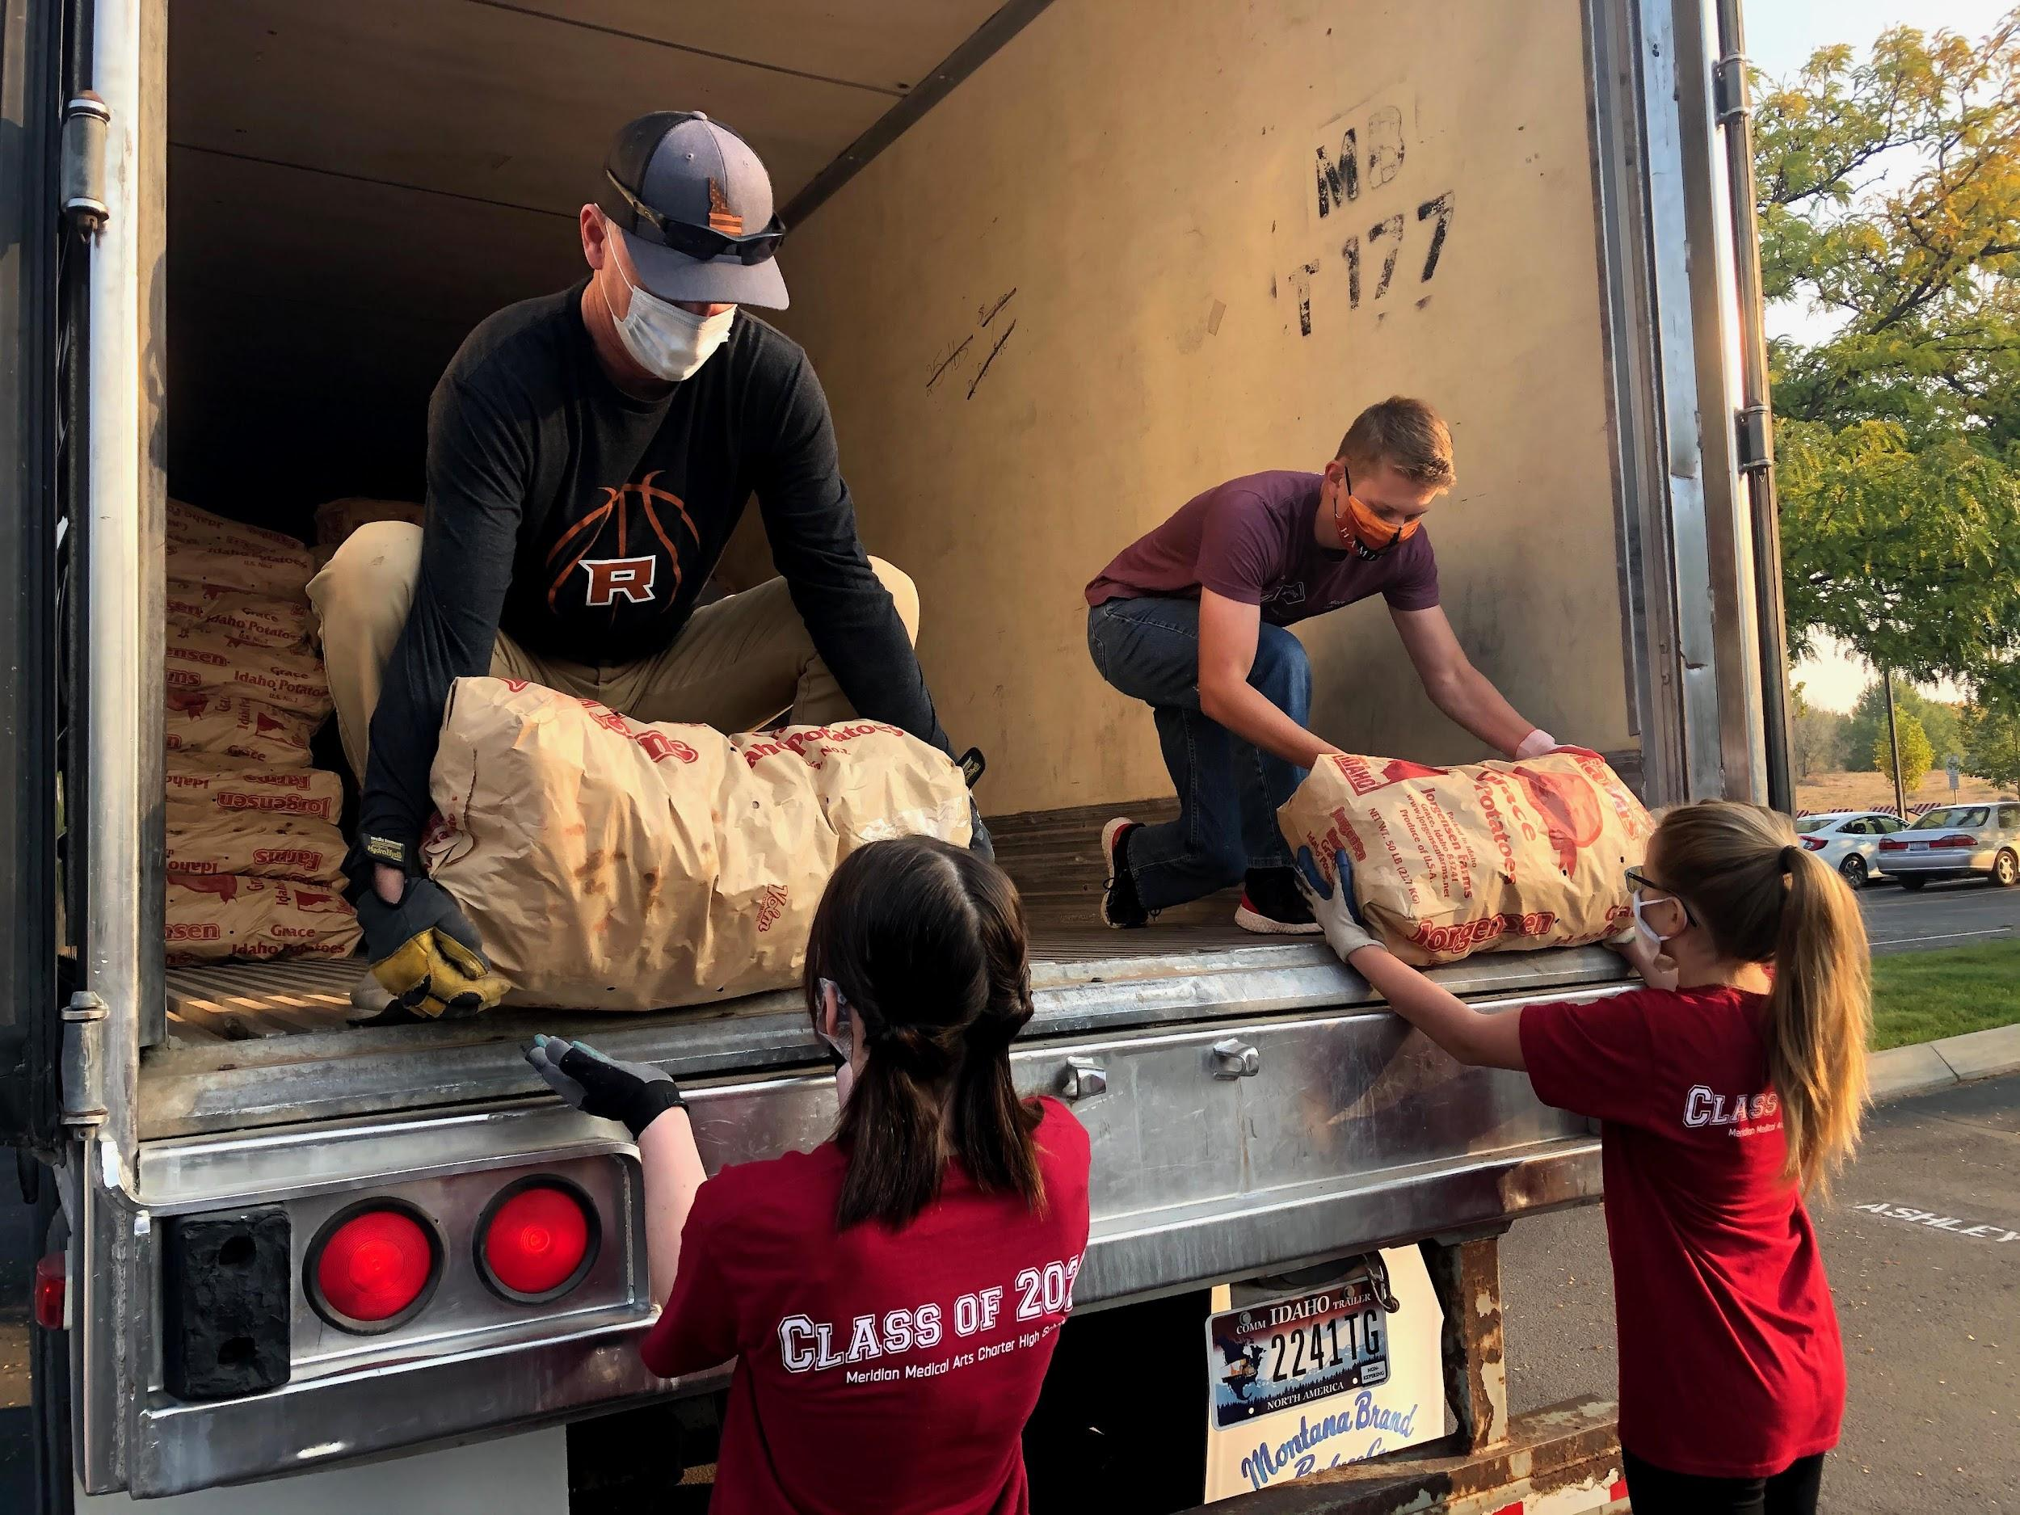
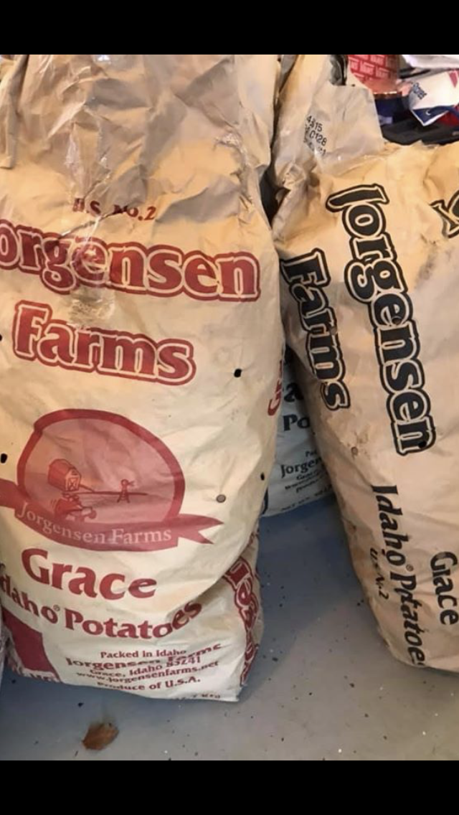
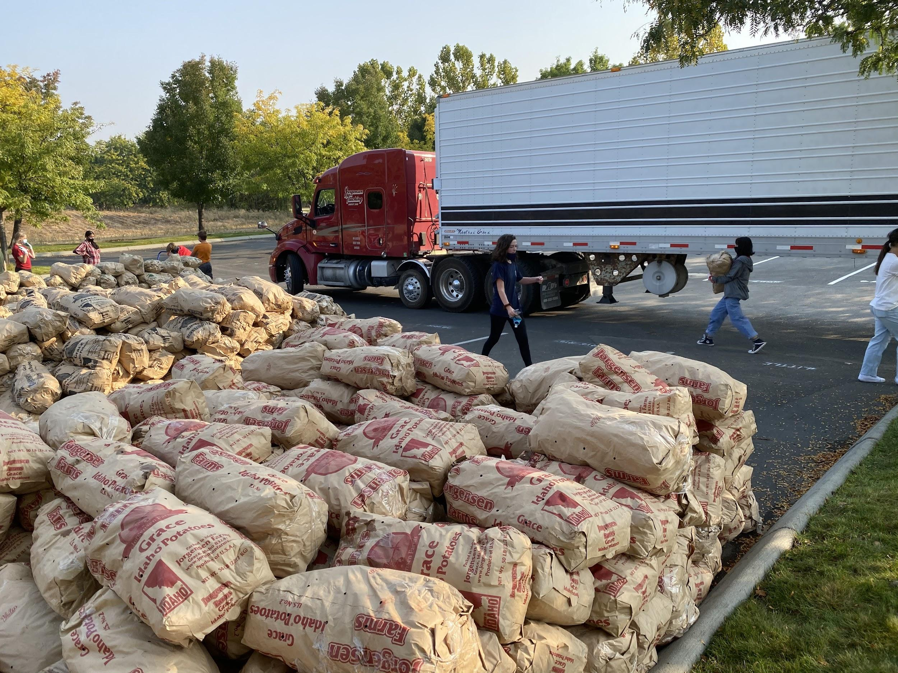
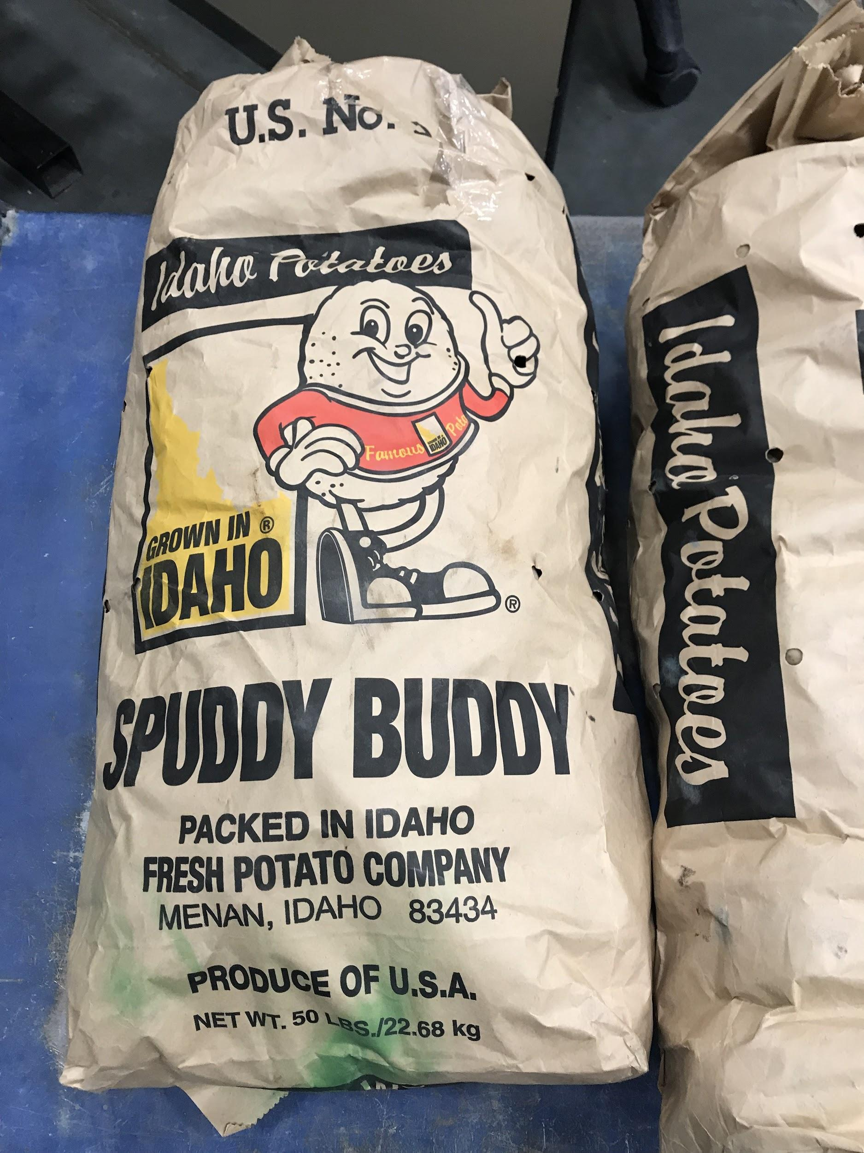
Fundraising-
Where does that money go?
Approx. 56 Students
Received FREE State Leadership Competition (SLC) fees by selling a minimum of 15 bags of potatoes at the 2022 fundraiser.
This equaled $5,600.00 in student scholarships!
proceeds are applied towards:
  Scholarships
  Meals and snacks
  Transportation
  Special event prizes
  Event needs
  Teacher appreciation

Slide 20
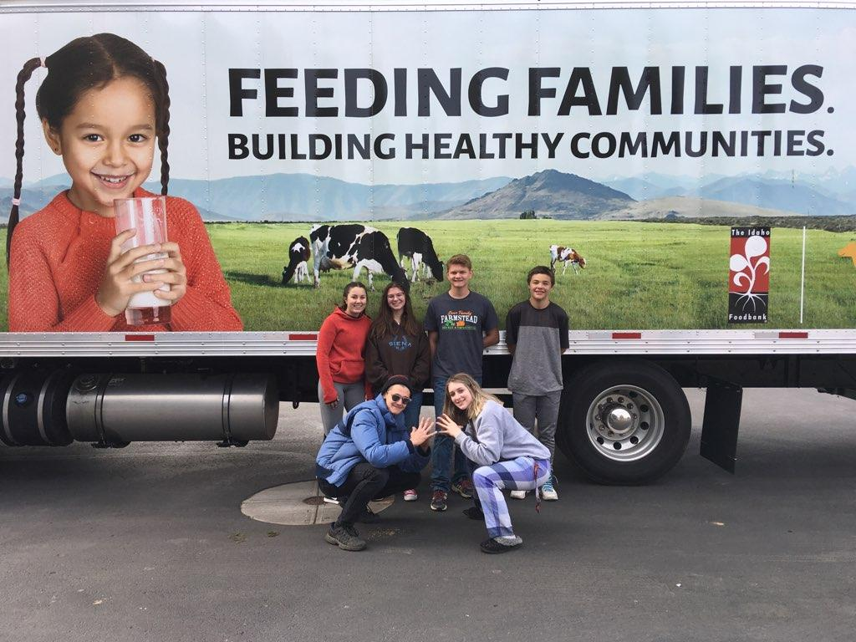
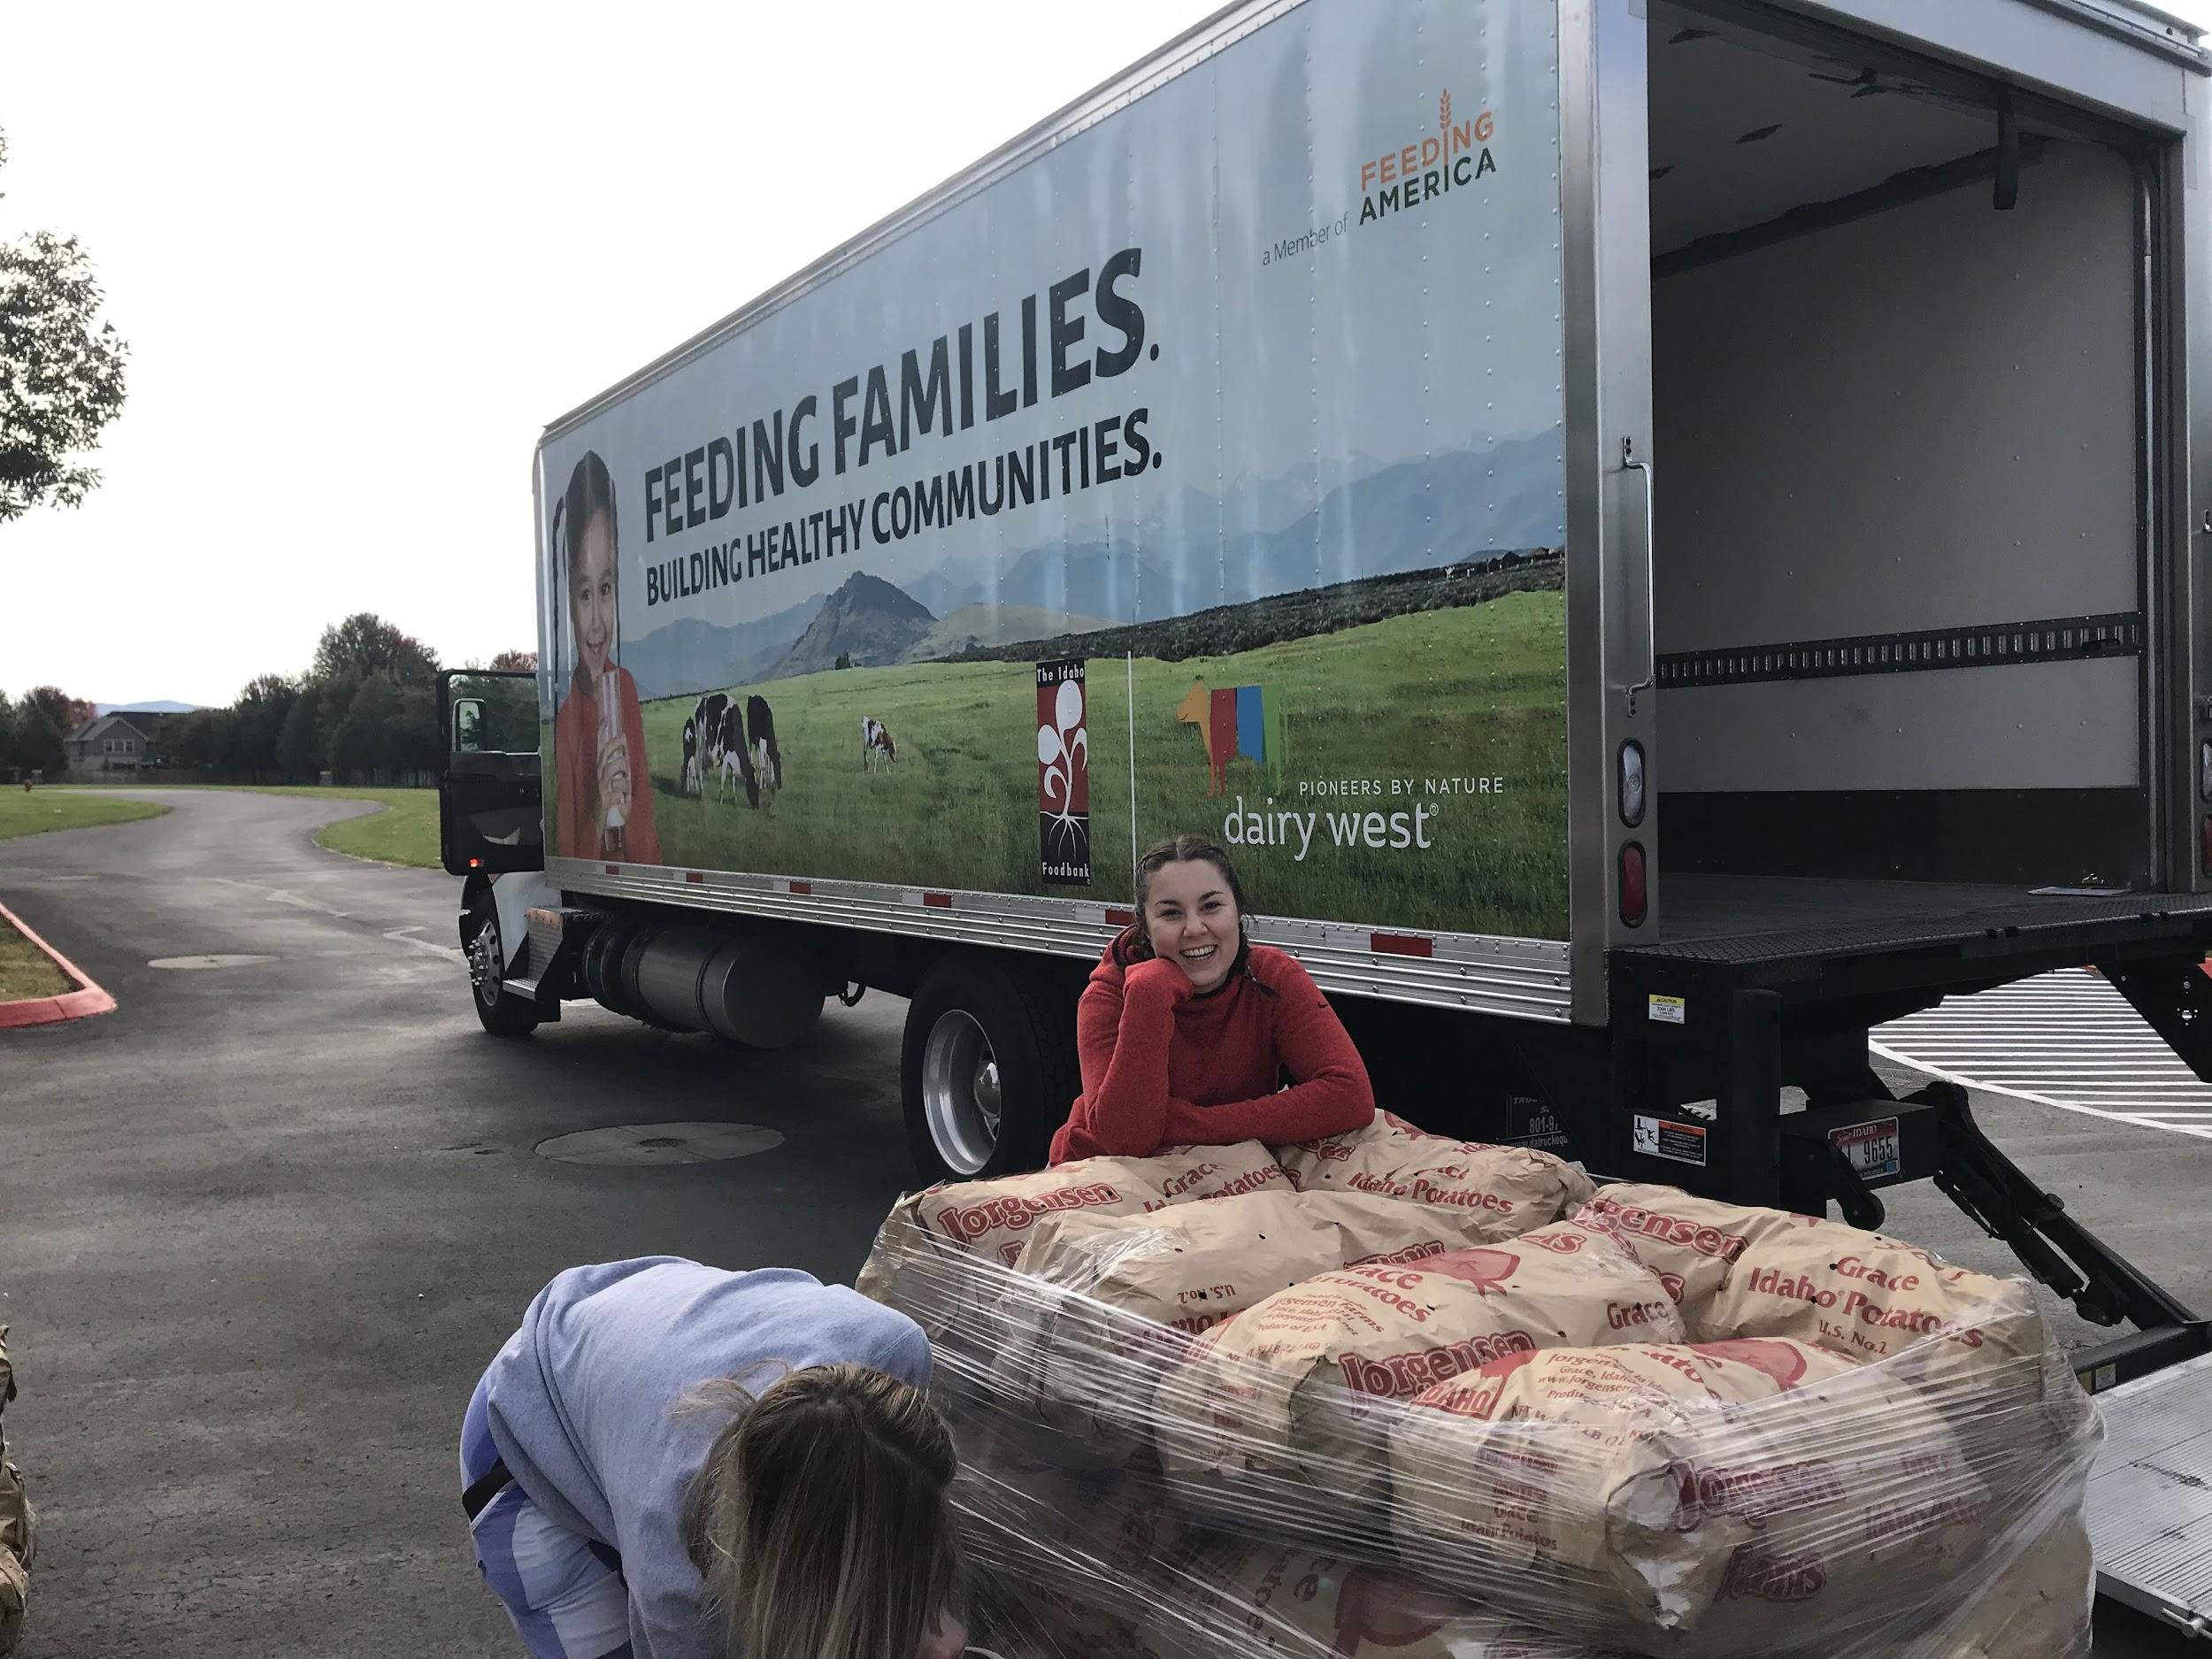
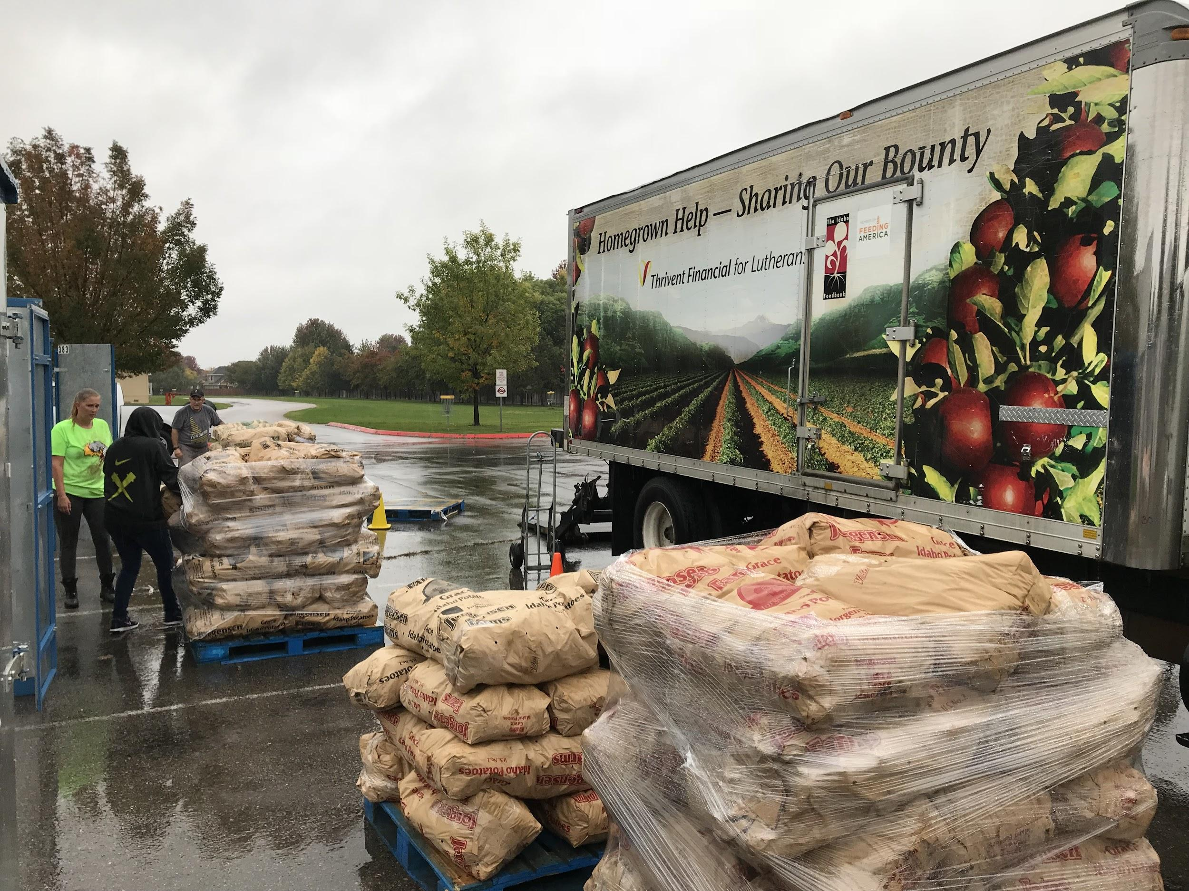
Giving Back to our communities..
This fundraiser is our largest community event too!
*Over 8,000 lbs donated this year.
Local Families supported
Idaho Food Bank
Star Food Bank
Meridian Food Bank
Fire Departments
Homeless Shelters
Let us know if you know of agencies, in need willing to pick up, extra and donated potatoes.

Slide 21
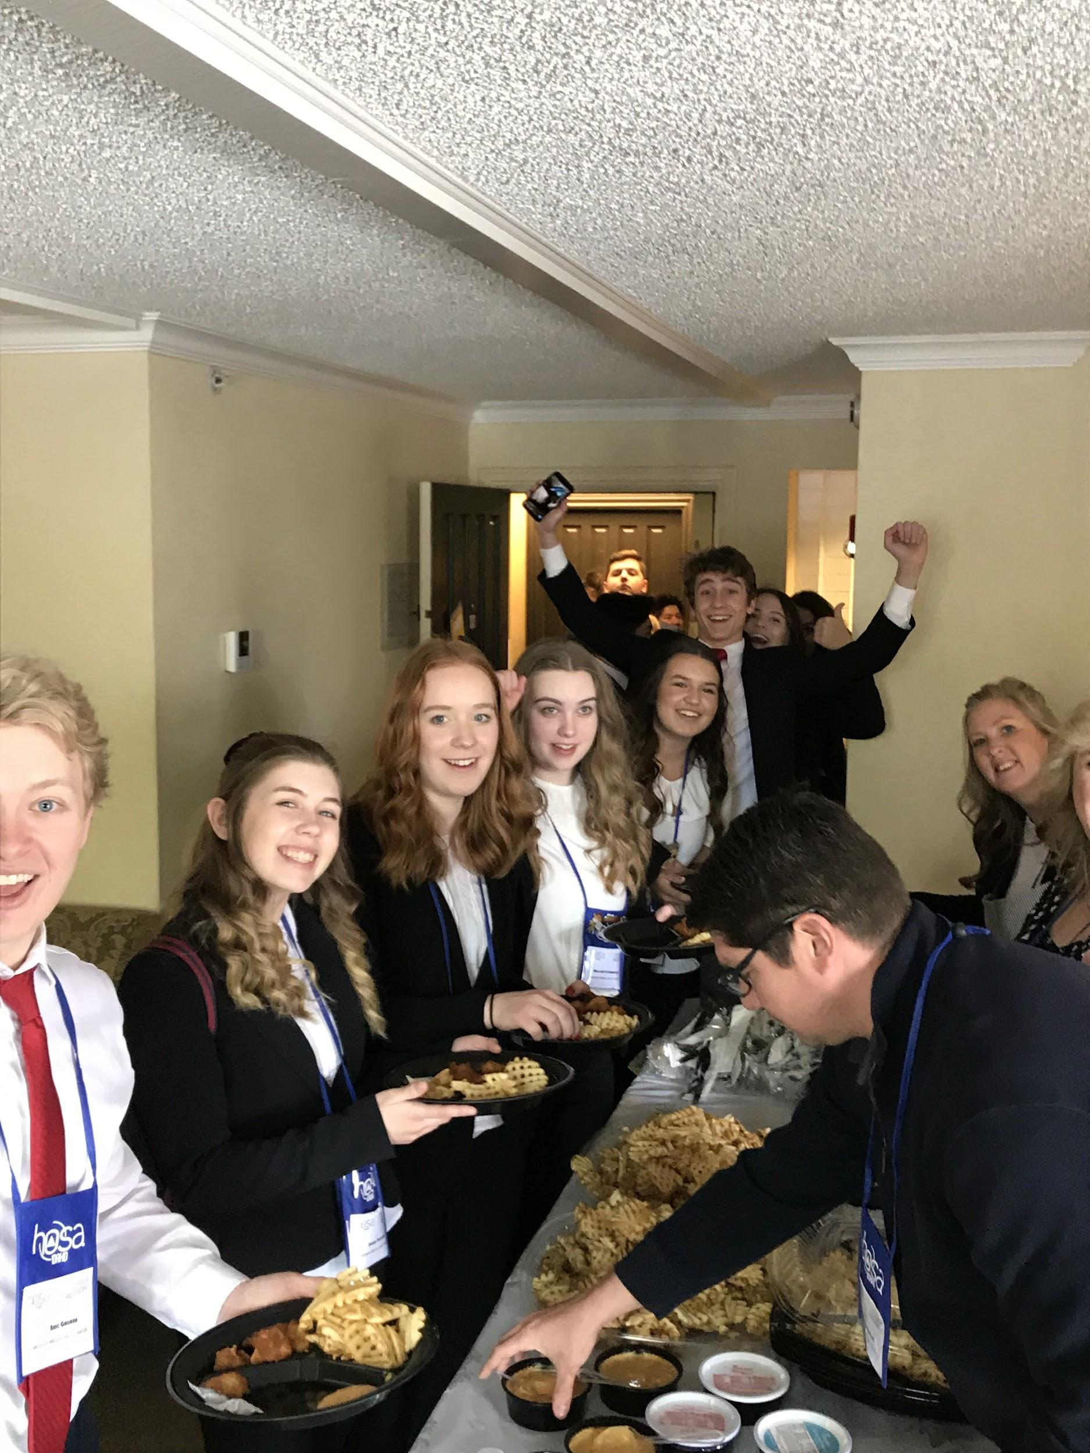
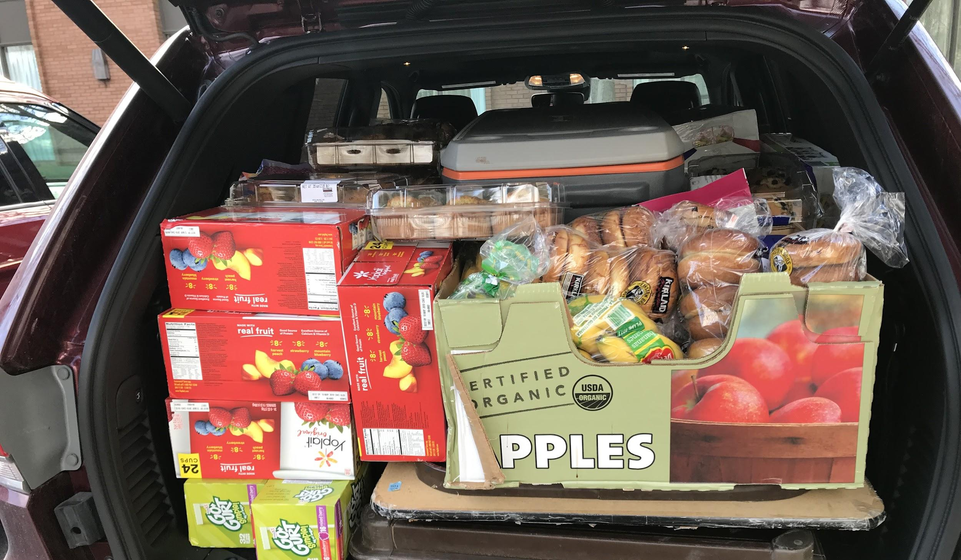
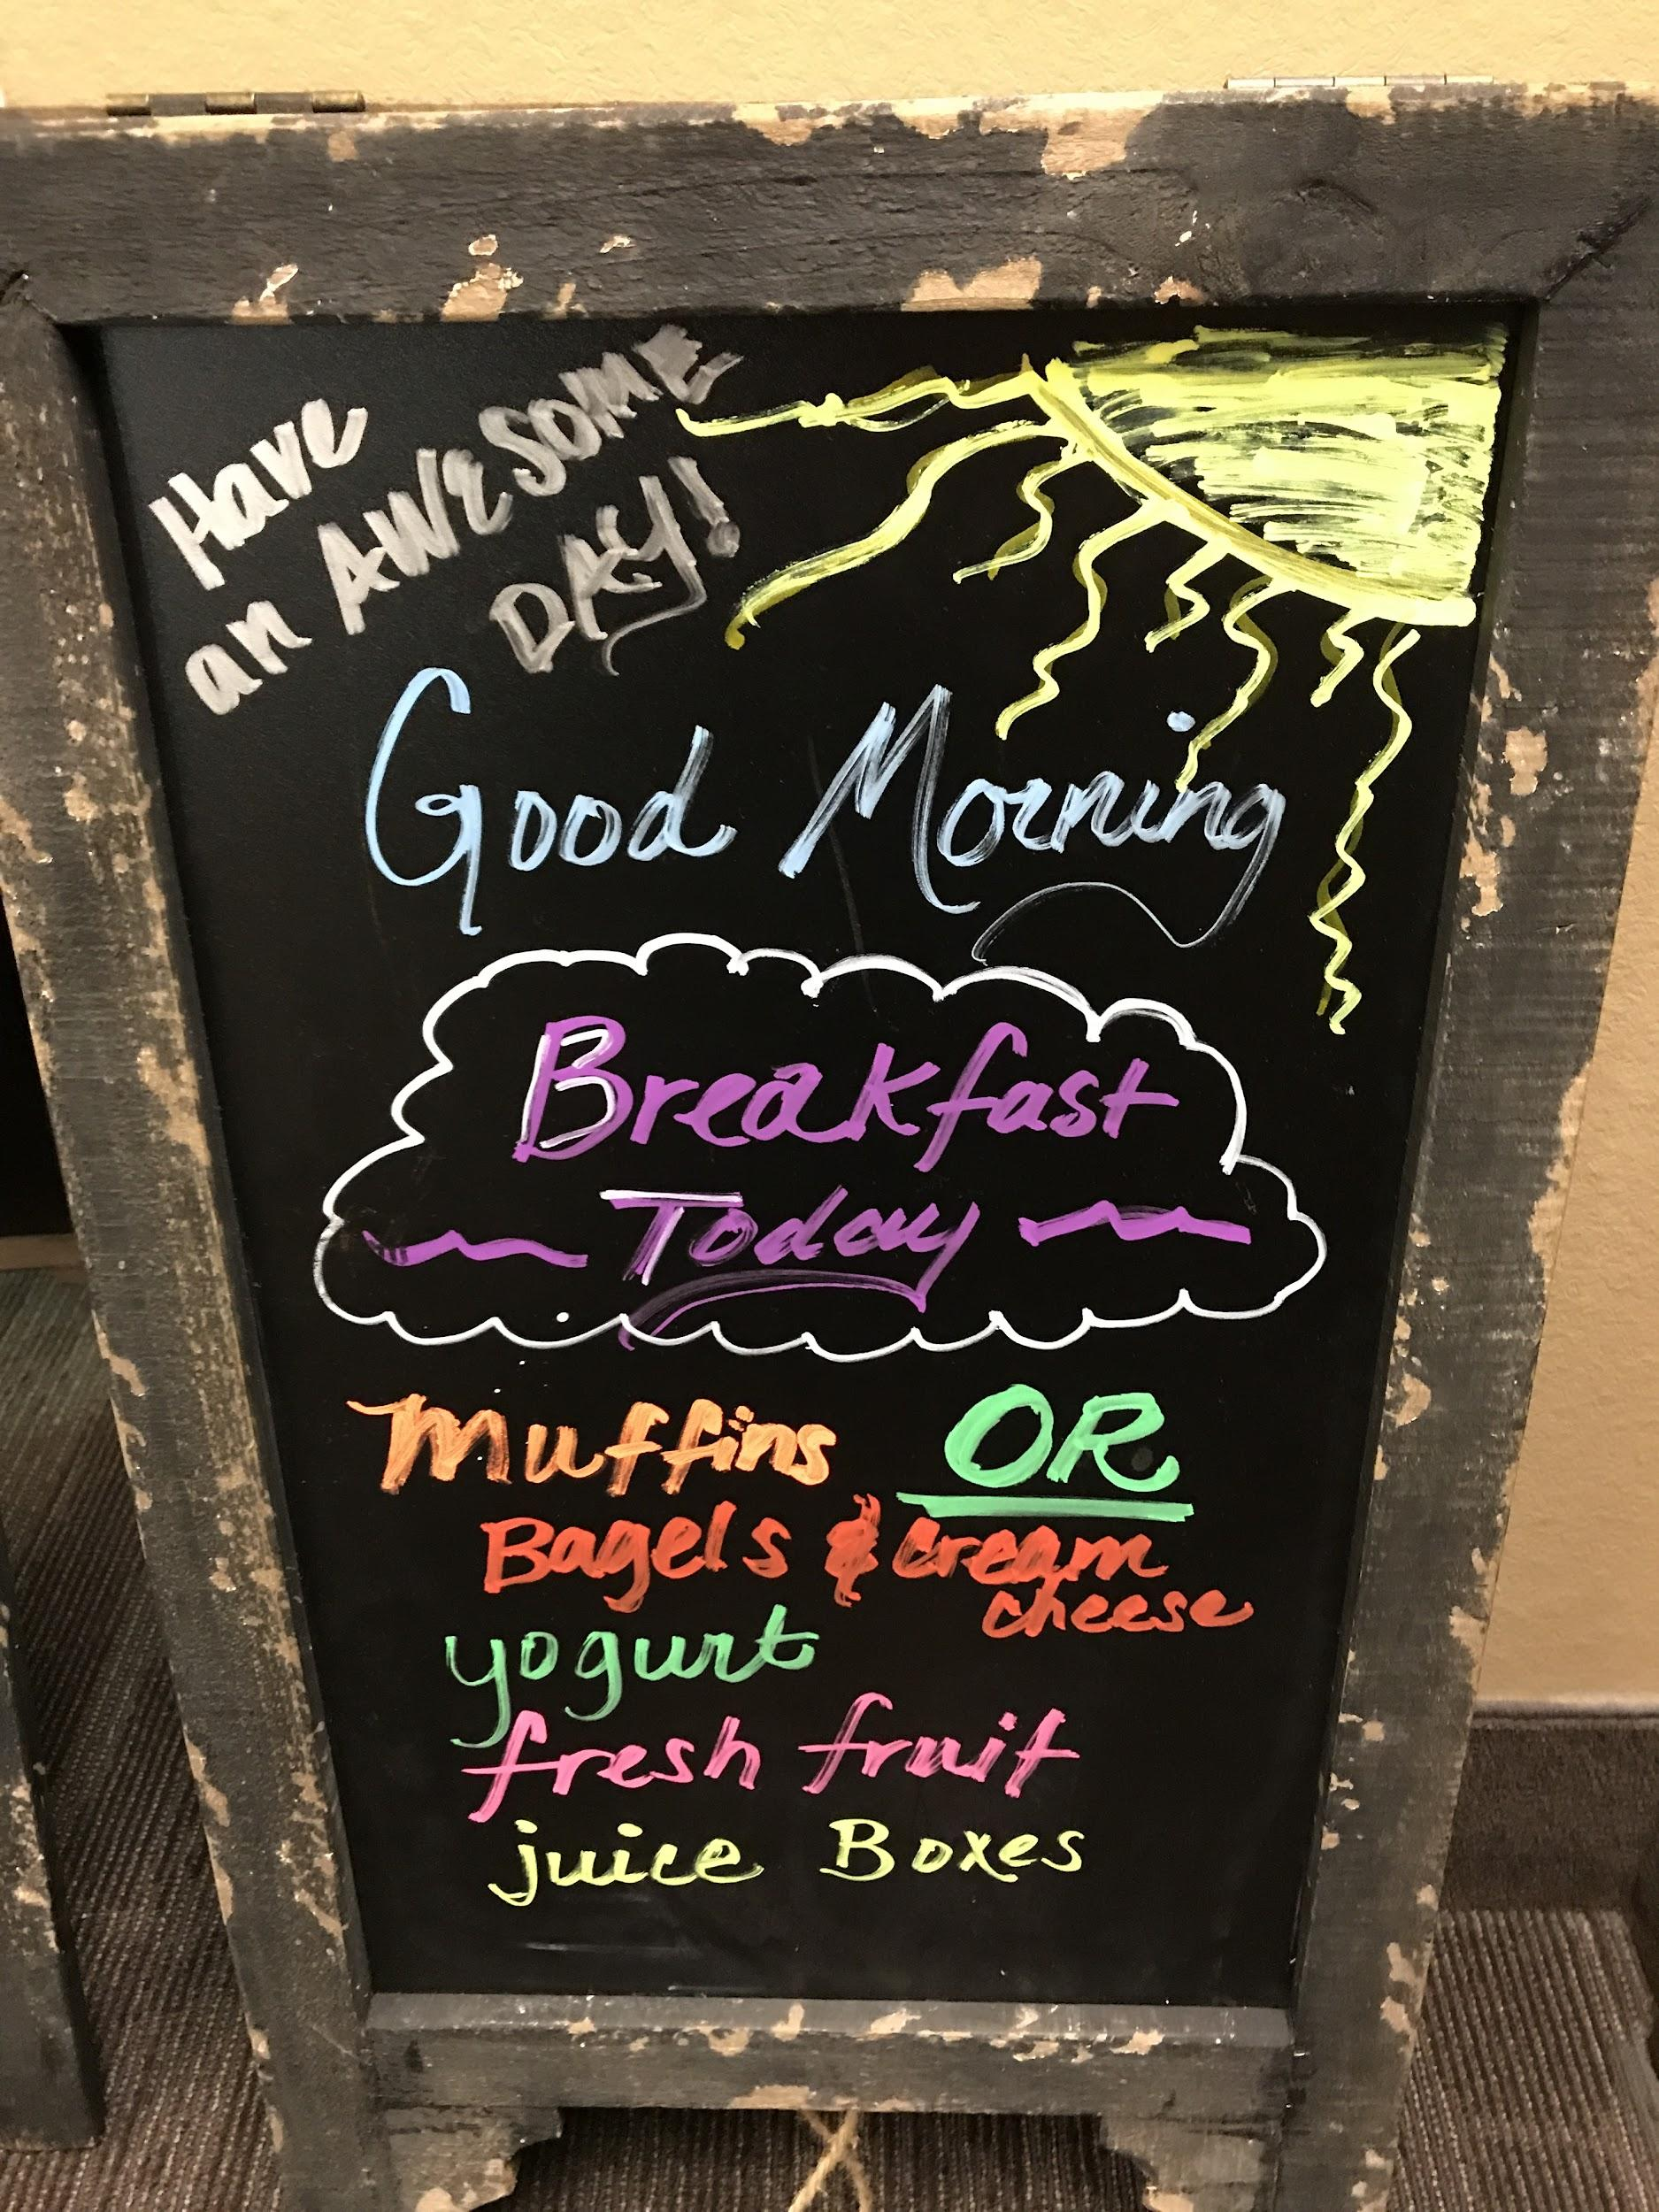
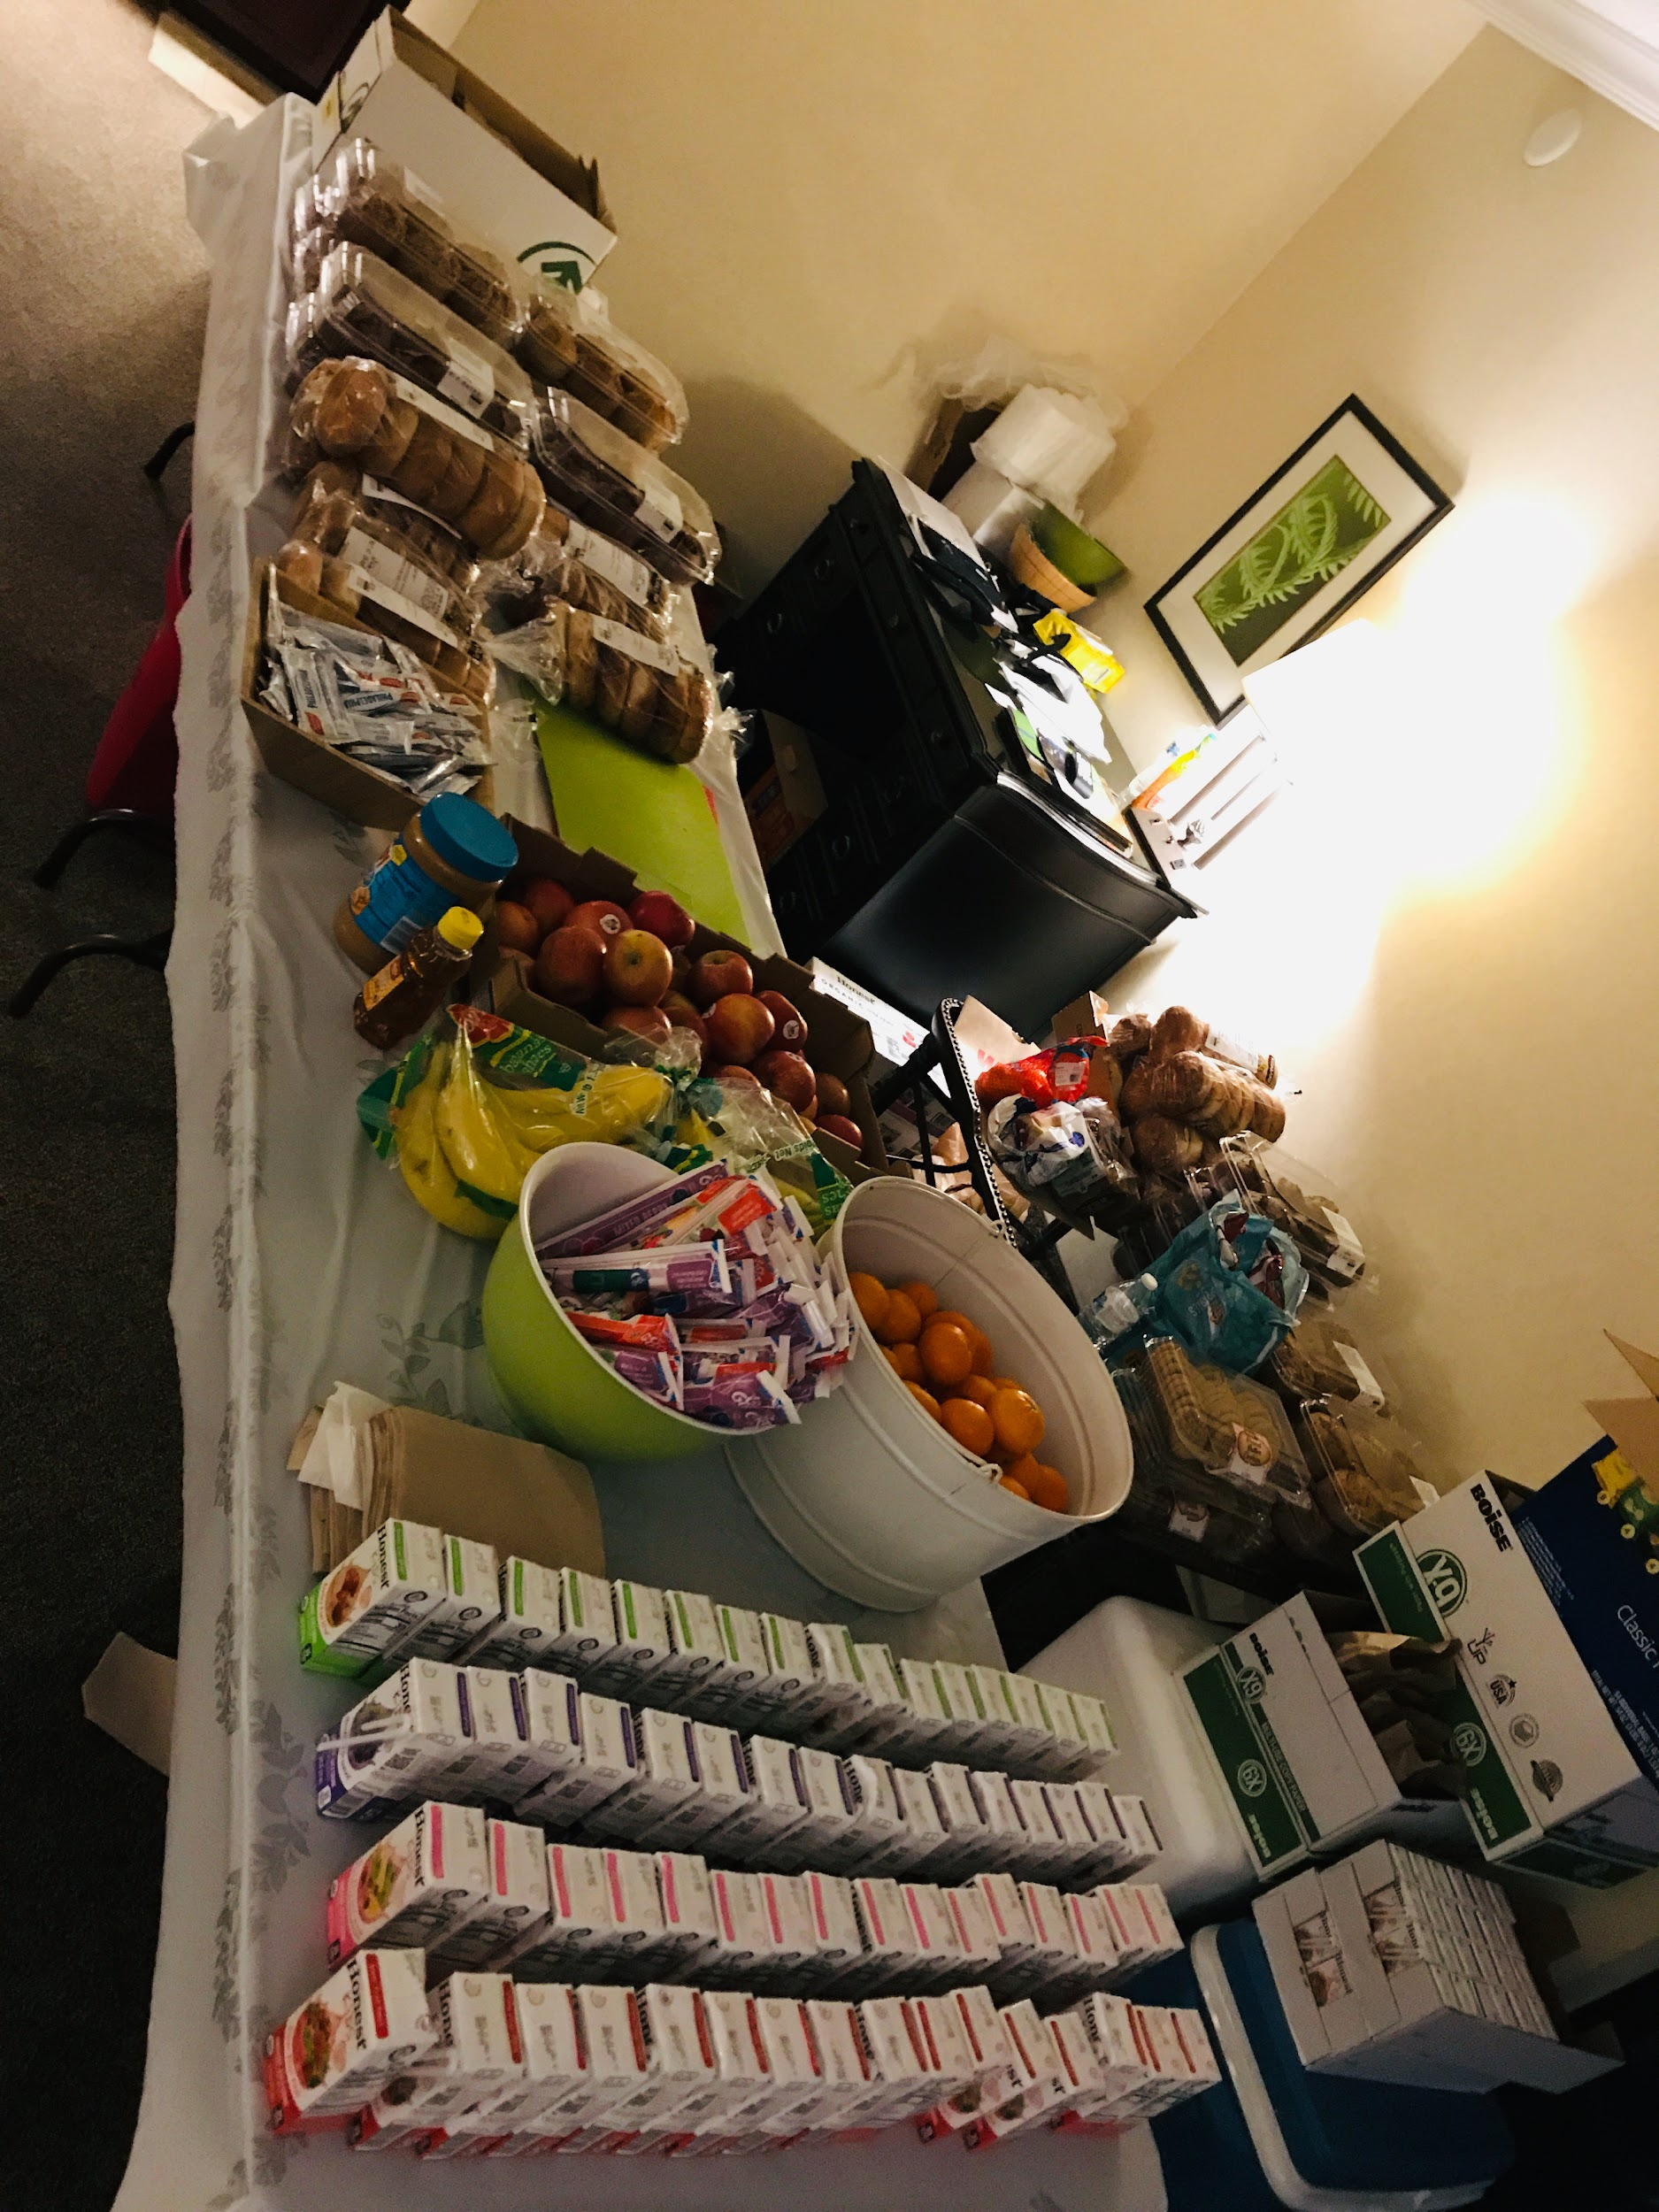
Meals and Transportation!!
Boosters help the most by Feeding the masses when at events! We provide meals, snacks, staff support and sometimes transportation.

Slide 22
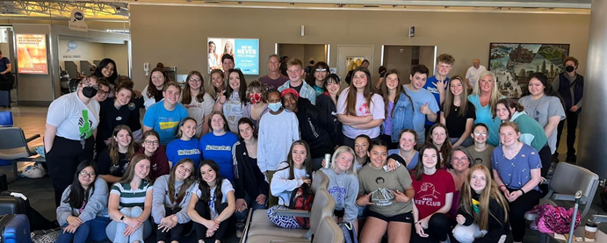
How can you support MMACHS HOSA?
Volunteer help for HOSA events, watch for newsletter, attend meetings, watch for signup genius and email us, bring IDEAS!

Slide 23


Notifications
Come to meetings
  2nd Tuesday at 6:30
Sign-up Genius
Watch for Monthly Newsletter
  Volunteer at events
  Food Needs
Website
  mmachshosaboosters.org

Slide 24
Leave a message with the school or Teacher advisors
Mr. Gaudet
Mrs. Kerns
mmachshosaboard@gmail.com
Ways to contact us?

Slide 25
Questions?

